Slide 1
Pre Work 1

Slide 2
Agenda
S.No | Topic
1 | Java Language Overview theory
2 | Installation and prerequisite to run java code
3 | JDK, JVM, JRE
4 | How does java work behind the scene
5 | Writing First Java program (Hello World)
6 | Keywords
7 | Variables

Slide 3
Java Language Overview
Developed by Sun Microsystems initiated by James Gosling in 1995
Write Once Run anywhere
Object oriented
Secure
Multithreaded
High performance
Architecture - neutral

Slide 4
Java Installation
Guide link : https://www.java.com/en/download/help/index_installing.html

Slide 5
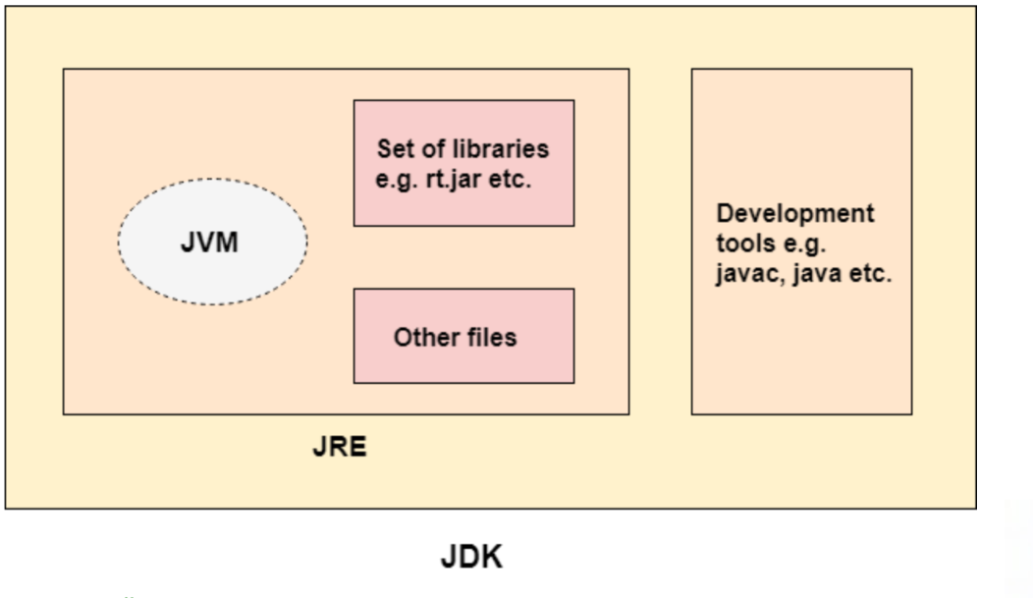
JDK, JVM, JRE

Slide 6
Java Working behind the scenes
→ Java is a compiled and interpreted language, so it will use both of them
→ We save your source code(program) as .java file, and when we compile this file, compiler will convert your .java file to .class file and this .class file is nothing but your byte code
→ JVM is interpreter which takes the byte code. The byte code gets loaded in the jvm loader and stores it in jvm memory where byte code verification happens, it first convert our source code into byte code and then jvm understands and interprets it to give us the output.
For more information https://www.mygreatlearning.com/blog/java-virtual-machine/

Slide 7
Java Hello World Program
class HelloWorldClass{
public static void main(String args[]){
System.out.println("Hello World");
}
}

Slide 8
Keywords
Java has a set of keywords that are reserved words that cannot be used as variables, methods, classes, or any other identifiers:
https://docs.oracle.com/javase/tutorial/java/nutsandbolts/_keywords.html

Slide 9
Variables
Variables are containers for storing data values.
In Java, there are different types of variables, for example:
String - stores text, such as "Hello". String values are surrounded by double quotes
int - stores integers (whole numbers), without decimals, such as 123 or -123
float - stores floating point numbers, with decimals, such as 19.99 or -19.99
char - stores single characters, such as 'a' or 'B'. Char values are surrounded by single quotes
boolean - stores values with two states: true or false
To create a variable, you must specify the type and assign it a value:
type variableName = value;
https://docs.oracle.com/javase/tutorial/java/nutsandbolts/variables.html

Slide 10
Thank You
Proprietary content. ©Great Learning. All Rights Reserved. Unauthorized use or distribution prohibited

